Slide 1
Floor Plan
We have 20 rectangle tables. Each table is 2.4m long by 1m wide and can fit a maximum of 4.5 people per side. We have 140 chairs.
Please move the tables on the floor plan (next pages) as you wish us to lay them out for your wedding reception. Do not resize tables as they are to scale.
Please only send through one layout, delete the other template slides on this document prior to sending back to us.
Maximum capacity: 150 people
Inclusions:
20 white tables 2.4m x 1m, 140 chairs, 4 outdoor couches, 6 high tables and 18 bar stools.
White tablecloths and napkins available.

Slide 2
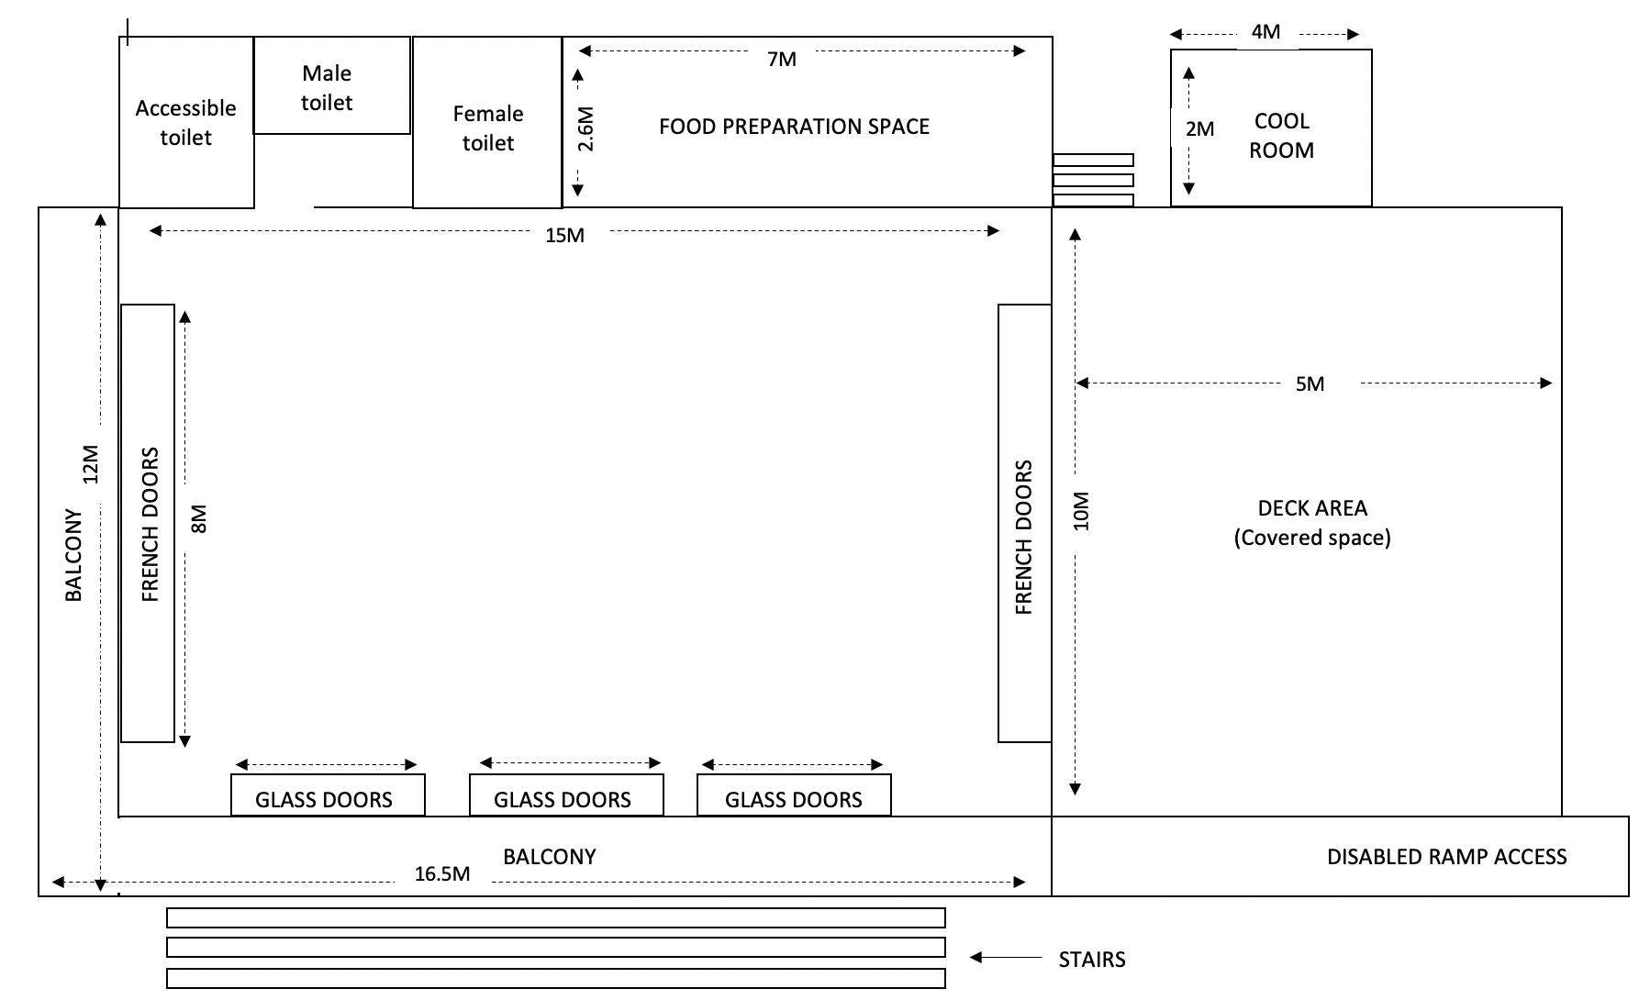
Maximum capacity: 150 people
Couch
Couch
Couch
Couch

Slide 3
Maximum capacity: 150 people
Couch
Couch
Couch
Couch
DJ

Slide 4
Maximum capacity: 150 people
DJ
Couch
Couch
Couch
Couch

