Slide 1
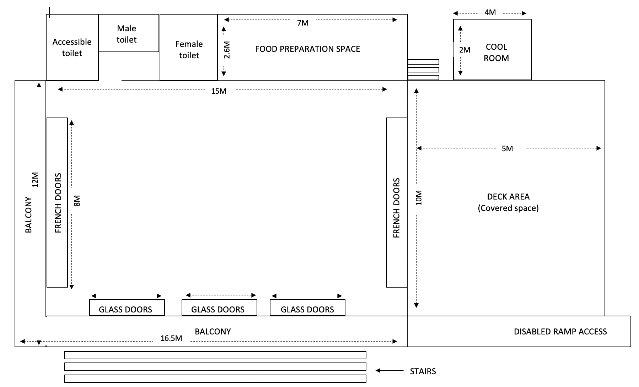
Maximum capacity: 150 people
Inclusions:
20 white tables 2.4m by 1m 150 chairs. 4 couches. 6 high bench tables and 18 bar stools
White tablecloths and napkins on demand
Max 5 people/side
Max 5 people/side
Couch
Couch
Couch
Couch

